Slide 1

Tailoring the effective properties of hybrid polymer based composite materials
Assoc. Prof. Dana LUCA MOTOC
Transilvania University of Brașov
Habilitation thesis
Mechanical Engineering field

Slide 2
Content
Part I – Scientific and professional achievements
  Chapter 1 - ‘State-of-the-art’ related to the approached subject
  Chapter 2 – Design of experiments
  Chapter 3 – Theoretical micromechanics based approaches
  Chapter 4 – Effective measured properties. Results and discussion
  Chapter 5 – Conclusions on the original work
Part II - The evolution and development plans of scientific and academic career
References

Slide 3
Part I - Scientific and professional achievements
Research is to see what everybody else has seen, and to think what nobody else has thought.
Albert Szent - Gyorgyi

Slide 4
Chapter 1 - ‘State-of-the-art’ related to the approached subject
1.1 Designing hybrid polymer composite materials
What is a hybrid material? When is hybrid a material?
How does it behave while subjected to a certain loading condition?
Scenarios used: “the best of both”, “the rule of mixtures”, “the weaker link dominates” and “the least of both”.
There are 3 types of hybridization architectures regarded as interlayer, intralayer and intrayarn. The interlayer hybridization implies reinforcement mixing on the layer level while the intralayer configurations within each layer.
Industry demands focuses on fast architecture optimization in terms of cost minimization, high performance and lightweight condition.

Slide 5
Chapter 1 - ‘State-of-the-art’ related to the approached subject
1.1 Designing hybrid polymer composite materials
One of the first review on hybrid composites was written by Kretsis in 1987. Since then, a wide range of materials was found to challenge the benchmarks.
One of the fundamental parameters in the hybrid polymer based composites design is the hybrid ratio that is acknowledged to have a direct influence on the overall performance of structure.
This is intimately connected to the hybrid effect that is generally assessed while approaching such materials’ architectures.
The most comprehensive and employed definition of the hybrid effect was given by Marom et al. in 1978. Deviation from linear rule of mixtures (RoM) can be modified to be used to predict a large spectrum of mechanical properties. The rule is known in literature as the linear rule of hybrid mixtures (RoHM).

Slide 6
Chapter 1 - ‘State-of-the-art’ related to the approached subject
1.1 Designing hybrid polymer composite materials
Influencing factors to be considered while retrieving/predicting hybrid composites’ effective material properties :
nature, distribution, amount, layering pattern and individual features of their constitutive
reinforcement’s and matrix materials
fiber-matrix interface, inter-laminar strength and fracture toughness
The study of hybrid composite materials is a multidisciplinary endeavor that overlaps with various branches of material science, engineering, applied mathematics, etc.
The ability to tailor hybrid composites with a unique spectrum of properties relies on relating the effective properties to the microstructure and correlation of experimental retrieved data with theoretical predicted values, bounded by certain processing conditions.

Slide 7
Chapter 1 - ‘State-of-the-art’ related to the approached subject
1.2 Material properties of hybrid polymer composites
Representative volume element (RVE) and repetitive unit cells (RUCs)
The micromechanical based approaches deployed were sought as a range of methods from fully analytical (e.g. rule of mixture (ROM) and Mori-Tanaka) to fully numerical (e.g. finite-element analysis (FEA) and molecular dynamics (MD)), or from semi-analytical (e.g. Generalized Method of Cells (GMC)) to fully numerical.
The key point behind the development of all the theories presented relayed on the balance between fidelity and efficiency that was met while applied to multi-scale modeling of composite materials.

Slide 8
Chapter 1 - ‘State-of-the-art’ related to the approached subject
1.2 Material properties of hybrid polymer composites
Mechanical properties of hybrid composites
Reports on the effects of the reinforcement clustering, individual material properties of constitutive on the overall composite behavior under mechanical loading.
Use of various hybrids based on synthetic/synthetic (Manders and Bader, 1981; Valenca et al. 2015), synthetic/natural (Priya et al., 2006; Reis et al., 2007; Almeida et al., 2012, 2013; Dhakal et al., 2013; Mansor et al., 2013; Romanzini et al., 2013) or natural/natural (Boopalan et al., 2013) materials combinations.
Scale transition issues.
Environmental influences (e.g. moisture absorption) and atmospheric, accelerated or thermal aging effects upon the mechanical properties of hybrid composite architectures.

Slide 9
Chapter 1 - ‘State-of-the-art’ related to the approached subject
1.2 Material properties of hybrid polymer composites
Dynamic mechanical properties of hybrid composites
Temperature-dependent dynamic mechanical properties (e.g. storage modulus, loss modulus and mechanical damping allow a closer monitoring of the level of interactions (i.e. adhesion) between the polymer matrix and the reinforcements.
Numerous reports on DMA data for synthetic/natural reinforcement combinations.
Effectiveness of reinforcements and adhesion factor can be traced and further used to assess the effectiveness of stress/strain between the reinforcements and matrix and their interface bonding.
Thermo-mechanical models using temperature-dependent mechanical properties of fibre reinforced polymer composites can be traced around ‘80s (see Mahieux et al., 2001, 2002).

Slide 10
Chapter 1 - ‘State-of-the-art’ related to the approached subject
1.2 Material properties of hybrid polymer composites
Thermo-physical properties of hybrid composites
References that can be traced for particle reinforced composites CTE’s due to their use in energy harvesting applications, power electronic, electronic packaging, sensing devices, actuators, etc. (Hatta et al., 2000; Zhao et al., 2007; Bai, et al., 2008; Tsai et al., 2009; Jefferson et al., 2009; Boualem et al., 2011)
Studies are scarcely about the thermo-physical changes occurring in CF reinforced composites developed for extreme environmental conditions.
Scale transition enabled particle/particle hybrid composite development out of micron size silicon dioxide (SiO2) and graphitized carbon nano-fiber (CNF) particles (Jang et al. 2011).

Slide 11
Chapter 1 - ‘State-of-the-art’ related to the approached subject
1.2 Material properties of hybrid polymer composites
Thermo-physical properties of hybrid composites
Contribution of Sevostianov (2012) can be ranked as comprehensive, proven the cross-property connection approach on thermal expansion and thermal conductivity .
Thermal conductivity of particle reinforced polymer composites were extensively investigated by Hatta and Taya (1991) who’s theoretical models are among the best predictors.
Scale transitions do not necessarily represent a viable solution from structural applications perspective.
Through-thickness and out-of-plane thermal conductivities of 3D woven carbon fiber reinforced polymer composites were investigated by Schuster and his co-workers (2008).

Slide 12
Chapter 1 - ‘State-of-the-art’ related to the approached subject
1.2 Material properties of hybrid polymer composites
Electrical properties of hybrid composites
Electronic composite is a material “whose function is primarily to exhibit electromagnetic, thermal, and/or mechanical behavior while maintaining structural integrity” (Taya, 2008).
Electronic packaging applications: printed circuit boards (PCBs), thermal interface materials (TIMs), or micro-electromechanical systems (MEMS) and BioMEMS where their functions are multi-fold: active sensing and housing.
Particle-fiber and fiber-fiber hybrid architectures developed using carbon black and carbon fiber reinforcements.
Scale transition - carbon nano-tubes (CNT), carbon black (CB) and carbon nano-fibers (CNF).
Temperature dependent properties - dielectric constant, dissipation factor and dielectric loss factor , etc.

Slide 13
Chapter 1 - ‘State-of-the-art’ related to the approached subject
1.3 Conclusions
Hybrid polymer composites development should tackle issues on: design, recycling, manufacturing processes, multi-scale approaches, availability, cost, substitution, etc.
Reflections on their overall behavior, interferences and synergies with direct consequences on their balanced properties should carefully be considered further while tailoring their architectures.
A sustainable development approach towards hybrid composite materials' deployment and ‘smart’ management should account:
  a balance of economic, social and environmental aspects
  a life cycle perspective and the direct implication of relevant actors (e.g. researchers, industry players, etc.).

Slide 14
Chapter 1 - ‘State-of-the-art’ related to the approached subject
1.4 Research general objectives
Objective 1 – issues to tackle in relation to hybrid polymer based composites architecture design;
Objective 2 – facilitating understanding of hybrid material characterization issues in conjunction with developed composite architectures in order to ensure mutual awareness and knowledge transfer from scientific researchers to industry players;
Objective 3 - providing input to further debates on hybrid composite materials' synthesis and characterization, full implementation of the existing state-of-art in the particular field approached or related scientific domains through smart specialization (e.g. young researchers, master and doctoral students, industry specialists, etc.).

Slide 15
Chapter 1 - ‘State-of-the-art’ related to the approached subject
1.4 Research general objectives
Objectives’ fulfillment achieved through:
An update on the scientific achievements and experts' views on the challenges of existing and future trends in hybrid polymer based composite materials, prior and post published references of the herein author.
Outlines of the inter-linkages between hybrid composite materials' design, manufacturing and characterization on future prospective applications, on the role of scientific data availability, understanding and use in the world-wide context of research and innovation.
Providing pointers to the systemic approach applied, balanced views and expanded research description developed throughout the individual chapters into a fashionable and contemporary manner.

Slide 16
Chapter 1 - ‘State-of-the-art’ related to the approached subject
Challenges
  Materials and structures design - to understand structures’ behavior while deploying experimentally retrieved material properties in the simulation environments; to size the dependences and interdependencies between the individual material properties, between the materials and environmental conditions, external loadings, etc.
  Simulation and modeling (scale transition: macro → micro →nano → pico ...) - to acknowledge on scale transition problems relaying upon a deep understanding on the materials’ structure at that particular level and related knowledge on material’s behavior at that particular scale.
  Manufacturing and testing - to be able to understand or identify a material related problem while designing/manufacturing or testing a mechanical structure.

Slide 17
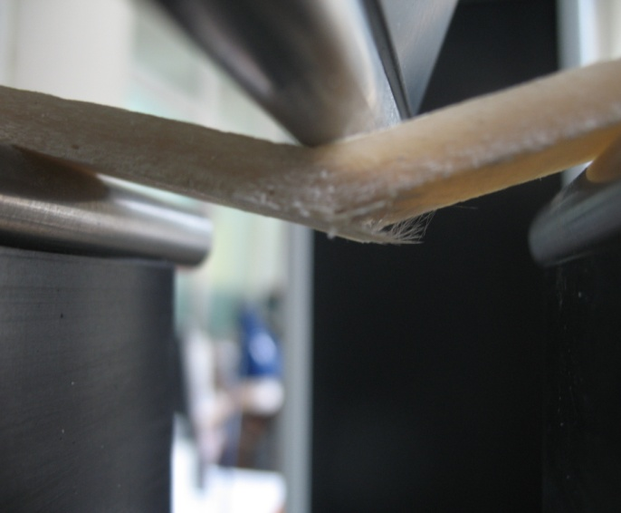
Chapter 2 – Design of experiments
Use of novel experimental devices and measuring procedures in accordance to EU and ASTM standards.
Various tailored hybrid polymer composite architectures (e.g. particle-particle, particle-fiber, fiber-fiber) using a wide range of available materials with different geometries and shapes, embedded within the polymer matrices in different volume fractions.
Deployment of different manufacturing technologies enabling fully cured specimens.

Slide 18
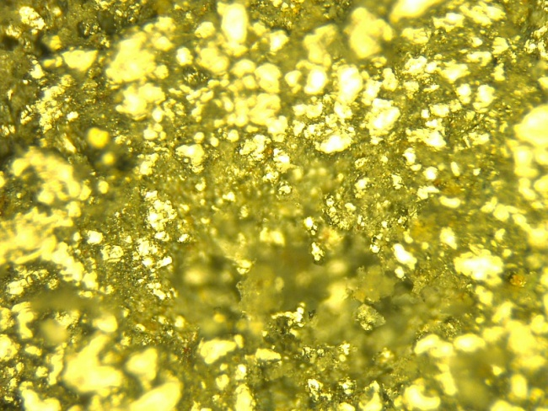
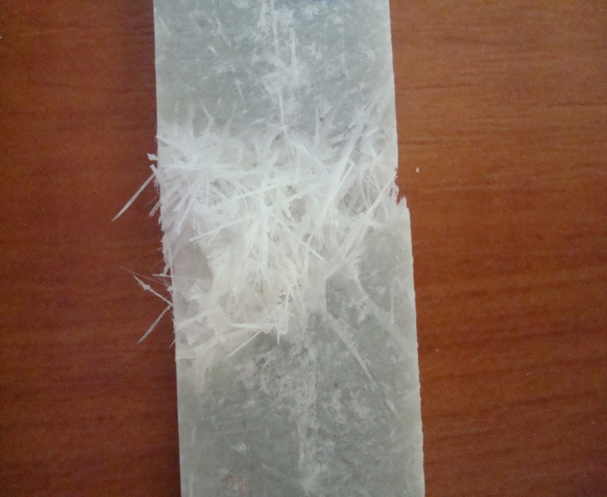
Chapter 2 – Design of experiments
Various specimen geometries due to experimental devices requirements.
Various temperature range, different specimen layering configuration, loading conditions, etc.
Distinct acquisition and data processing software.
Access to several , individual locations for the experimental measurements.

Slide 19
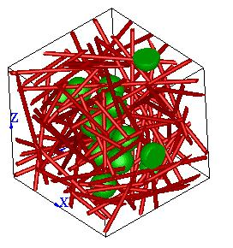
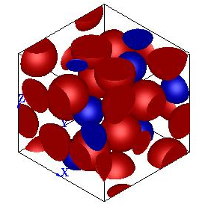
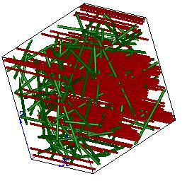
Chapter 3 - Theoretical micromechanical based approaches
The micromechanical approach methodology was developed as a useful tool for predicting the material properties – mechanical, thermal or electrical – of composite materials, based on the volume/mass ratio of the phases, geometrical parameters (e.g. size, length and shape), distribution, type of phases, etc., in the form of:
effective material property = f(structural parameter)
Course of actions:
  numerical predictions by the aid of a professional multi-scale modeling software platform from e-Xstream Engineering;
  numerical predictions based on theoretical models by the aid of commercially available software (e.g. Excel from Microsoft Office, PTC Mathcad, Matlab, Maple, Mathematica, etc.).
RVEs used in effective material properties predictions

Slide 20
Chapter 3 - Theoretical micromechanical based approaches
Microstructure description
  Matrix/inclusion void microstructures
    inclusion phase (behavior – deformable, incrementally rigid)
    void phase
  Phase parameters
    volume fraction
    shape
    orientation
    percolation parameters
  Coatings
Sensitivity due to material’s microstructure – shape, orientation, volume fraction of the fillers.

Slide 21
Chapter 3 - Theoretical micromechanical based approaches
3.1 Effective elastic modulus
Rule of the hybrid mixtures (RoHM)

Slide 22
Chapter 3 - Theoretical micromechanical based approaches
3.2 Effective complex elastic modulus
  Storage modulus (E’) - closely related to the load bearing capacity of a material
  Mechanical loss factor (tan δ) and modulus (E’’) - related to the impact resistance of a material and provides the balance between the elastic and viscous phases in a polymeric structure.
  RoM
  iRoM

Slide 23
Chapter 3 - Theoretical micromechanical based approaches
3.3 Effective thermal expansion
Hybrid particle-fiber polymer composites
Mechanics of materials & Hashin-Rosen
Mechanics of materials & Levin-Hashin-Shtrikman

Slide 24
Chapter 3 - Theoretical micromechanical based approaches
3.3 Effective thermal conductivity
Hybrid particle-fiber polymer composites
Hashin-Shtrikman bounds

Slide 25
Chapter 3 - Theoretical micromechanical based approaches
3.3 Effective thermal expansion
Hybrid fiber-fiber polymer composites
Longitudinal direction
Transversal direction
Shapery
Hopkins-Chamis

Slide 26
Chapter 3 - Theoretical micromechanical based approaches
3.4 Effective electrical conductivity
Hashin-Shtrikman bounds
Milton

Slide 27
Chapter 4 - Effective measured properties. Results and discussion
4.1 Mechanical properties
Hybrid particle-fiber polymer composites
Particle-fiber hybrid composites’ Young modulus from tensile tests
Particle-fiber hybrid composites’ Young modulus in flexure

Slide 28
Chapter 4 - Effective measured properties. Results and discussion
4.1 Mechanical properties
Hybrid particle-fiber polymer composites
Theoretical predicted values based on the multi-step homogenization
scheme used for particle-fiber reinforced polymer composites
Percent relative error between theoretical and experimental Young modulus from flexure tests

Slide 29
Chapter 4 - Effective measured properties. Results and discussion
4.1 Mechanical properties – environmental effects
Hybrid particle-fiber polymer composites
Percent difference between Young modulus in flexure: room and low temperature conditioned (left); room and temperature range (right)

Slide 30
Chapter 4 - Effective measured properties. Results and discussion
4.1 Mechanical properties
Hybrid fiber-fiber polymer composites
Load vs. extension curves for unsymmetrical
hybrid and reference composites in flexure
Mean maximum bending stress values retrieved
for the hybrid fiber-fiber polymer composite specimens

Slide 31
Chapter 4 - Effective measured properties. Results and discussion
4.2 Dynamic mechanical properties
Hybrid particle-fiber polymer composites
Storage modulus (E’)
Loss modulus (E”)
Particle content effects on the storage modulus at different temperatures
Particle content effects on the loss modulus at different temperatures

Slide 32
Chapter 4 - Effective measured properties. Results and discussion
4.2 Dynamic mechanical properties
Hybrid particle-fiber polymer composites
Damping factor/loss tangent (tan δ)
Cole-Cole plots
Damping factor variation with temperature in particle-fiber hybrid architectures
Cole-Cole diagrams for the particle-fiber polymer composites

Slide 33
Chapter 4 - Effective measured properties. Results and discussion
4.2 Dynamic mechanical properties
Hybrid fiber-fiber polymer composites
Storage modulus (E’)
Loss modulus (E”)
Reinforcements’ volume fraction and UD fiber orientation effects on the storage modulus
Reinforcements’ volume fraction and UD fiber
orientation effects on the loss modulus

Slide 34
Chapter 4 - Effective measured properties. Results and discussion
4.2 Dynamic mechanical properties
Hybrid fiber-fiber polymer composites
Cole-Cole plots
Cole-Cole diagrams in 0° oriented UD carbon fibers
of hybrid fiber-fiber polymer composites
Cole-Cole diagrams in 90° oriented UD carbon fibers
of hybrid fiber-fiber polymer composites

Slide 35
Chapter 4 - Effective measured properties. Results and discussion
4.3 Thermo-physical properties – thermal expansion (CTE)
Hybrid particle-fiber polymer composites
Instantaneous CTE values (at 25 °C) for samples undergoing two successive scans
Comparison on theoretical predicted vs. experimental retrieved CTE values

Slide 36
Chapter 4 - Effective measured properties. Results and discussion
4.3 Thermal expansion - hygroscopic environments
Hybrid particle-fiber polymer composites
CTE temperature variations after water exposure along 1 week
CTE temperature variations in reference specimens

Slide 37
Chapter 4 - Effective measured properties. Results and discussion
4.3 Thermal expansion - hygroscopic environments
Hybrid particle-fiber polymer composites
Thermal strain fields’ evolution within composites after 12 week of water exposure
Thermal strain fields’ evolution within 10% Al₂O₃ specimens under water exposure

Slide 38
Chapter 4 - Effective measured properties. Results and discussion
4.3 Thermal expansion – temperature range
Hybrid particle-fiber polymer composites
CTE temperature variations in samples prior subjected to temperature range
Theoretical predicted vs. experimental retrieved CTE values for Al₂O₃ fillers

Slide 39
Chapter 4 - Effective measured properties. Results and discussion
4.3 Thermal expansion – low temperature
Hybrid particle-fiber polymer composites
Thermal strain fields’ evolution within composites prior undergoing low temperature
Overall CTE temperature variations after low temperature exposure

Slide 40
Chapter 4 - Effective measured properties. Results and discussion
Thermal conductivity
Hybrid particle-fiber polymer composites
Effective thermal conductivities – experimental vs. theoretical predicted
Relative errors between the experimental and predicted thermal conductivities

Slide 41
Chapter 4 - Effective measured properties. Results and discussion
Thermo-physical properties
Hybrid fiber-fiber polymer composites
Thermal strain fields’ evolution within the composite specimens
Effective CTE mean values from successive thermal cycles

Slide 42
Chapter 4 - Effective measured properties. Results and discussion
Thermo-physical properties
Hybrid particle-particle polymer composites
Thermal strain fields developed within hybrid composites during heating
CTE mean experimental values vs. micromechanical predicted

Slide 43
Chapter 4 - Effective measured properties. Results and discussion
Electrical properties
Hybrid particle-particle polymer composites
R(I) variation with applied current intensity for multi-phase composite specimens
Comparative theoretical-experimental data on effective
electrical conductivity for different relative content of iron particles

Slide 44
Chapter 4 - Effective measured properties. Results and discussion
Electrical properties
Hybrid particle-particle polymer composites
Absolute values of relative percent error from experimental and predicted values on effective electrical conductivities of hybrid composites
Effective electrical conductivity function of relative iron particle
content in hybrid iron-graphite reinforced PVAc based composites

Slide 45
Chapter 5 – Conclusions on the original work
Mechanical properties of hybrid polymer composites
Elastic properties of hybrid polymer combinations are highly influenced both by the volume fraction of particle reinforcements and material type (i.e. ceramic, metallic) in addition to their geometry, shape and distribution.
The effective mechanical properties of these hybrid composites are being also influenced by the capacity of stress transferring between the fibre-matrix interfaces and fibres’ different breakage mechanisms.
Environmentally hybrid polymer composite conditioning (e.g. low temperatures, temperature range, water immersion, etc.) further impacts the experimentally retrieved elastic property in some extends, thus revealing information on materials’ sustainability.

Slide 46
Chapter 5 – Conclusions on the original work
Dynamic mechanical properties of hybrid polymer composites
In all cases the storage and loss modulus revealed the same tendencies, namely a decrease as the temperature increases, which is associated with the softening of the polymer matrices at higher temperatures.
Damping factors reveal a negative shift around glass transition temperature value as the volume fraction of phases increase, revealing thus an increase in the mobility of polymer molecules on the particle/fiber/matrix interfaces.
Micromechanical predictions made using linear rules of hybrid mixture (RoHM) and inverse rules of hybrid mixture (iRoHM) reveal positive hybrid effects.
Cole-Cole diagrams reveal the heterogeneity of the hybrid polymer composites as well as the relatively good reinforcements/matrix interface.

Slide 47
Chapter 5 – Conclusions on the original work
Thermo-physical changes of hybrid polymer composites
Both thermal strain fields and instantaneous CTE are experiencing differences as temperature increases due to both constitutive concentration and orientation.
Instantaneous CTE curves enable supplementary property retrieval, namely glass transition temperature on the curve peak. This parameter is particular important while testing a novel polymer matrix and a tailored hybrid composite architecture.
Theoretical predicted vs. experimentally retrieved CTE values shown small discrepancies if the double inclusion method was accounted comparatively with the well-known Mori-Tanaka model.

Slide 48
Chapter 5 – Conclusions on the original work
Electrical properties of hybrid polymer composites
The electrical conductivity of herein tailored hybrid polymer combinations’ ranks within semiconductor range (i.e. 10⁻² to 10² Ω·m) and increases with the increase of current density.
The effective electrical resistivity experiences an abrupt decrease with the increase on the metallic particle volume fraction and increase of the current density applied.
Differences between the experimentally retrieved and predicted values of effective electrical conductivities (e.g. Milton and Hashin-Shtrikman bounds) should be sought to relay on the reinforcements’ distribution and agglomeration within the hybrid composite structure that highly contributed to particle-particle interfaces enabling the conductive paths.

Slide 49
Part II - The evolution and development plans of scientific and academic career

Slide 50
Directions of scientific research
To foster novel hybrid woven out of solely synthetic/natural fibres or combinations of their (e.g. inter, intra- or comingled) and/or either natural or synthetic resin types followed by emerging tailored architectures to address the performance criteria and optimization designs settings.
To surmount shortages of skills and fill-in gap with missing information on the: fibre/matrix materials' compatibility, reinforcement structure and chemical composition or manufacturing techniques by extensive experimental research.
To address issues related to life cycle analysis (LCA), life cycle costing (LCC) and social life cycle assessment (SLCA) of polymer based composites, generally and hybrids, particularly.

Slide 51
Evolution and development plans of professional career
Teaching activity
Long term experience with university teaching since 1992.
Subjected to changes and continuous improvements since is running into a feed-back type loop.
Continuous learning both as provider and beneficiary (e.g. post-graduate courses)
  Impact dynamics and testing methods and multiscale modelling of the mechanical behaviour and fatigue damage of engineering materials, University of Hertfordshire, UK, 3rd – 8th July 2008
  Computational and experimental mechanics of advanced materials, International Centre for Mechanical Sciences, Udine, Italy, 8th – 12th Sept. 2008
  Optical methods in experimental solid mechanics, Transilvania University of Brasov, Romania in collaboration with University of Poitier, France, 15th – 17th Nov. 2004
Evaluation and self-assessment of the current activities are continuously monitored, both externally and internally, by expert bodies and academia beneficiaries.

Slide 52
Evolution and development plans of professional career
Teaching activity
European dimension
  lecture with M.Sc. specialization in Computer-Aided Design and Manufacturing University of Valencia, 17-25 April 2012
  Challenging the classical path: new approaches in polymer based composites modeling and simulation
  PYCO Fraunhofer Research Institution for Polymeric Materials and Composites and Brandenburg Technical University at Cottbus, 30 Sept. 2013
  Polymer reinforced composites: an engineering perspective
  Erasmus + faculty coordinator (since February 2014)

Slide 53
Evolution and development plans of professional career
Research activity
Publishing activity:
  Author and co-author of more than 130 scientific articles (15 articles in ISI journals, 25 articles in ISI proceedings, 75 in proceedings of international conferences world-wide)
  Author and co-author of 12 books (5 – unique author, 4 – first author)
  Author and co-author of 2 patens
    Pressure-force transducer embedded in concrete pillars (registered proposal)
    Adjusting resistor made of a piezo-resistive based effect composite material (RO 123411/2012)
  team member in 3 projects (after 2000)

Slide 54
Evolution and development plans of professional career
Research activity
  Presentations delivered with Romanian Academy, Thermal Analysis and Calorimetry commission
  PhD external evaluator
    March 2011, Polytechnic University of Valencia, Thesis title – Using natural based plasticizers to obtain flexible PVC low environmental impact, Author: Octavio Angel Fenollar Gimeno, PhD supervisors: Juan Lopez Martin, Rafael Antonio Balart Gimeno.
    March 2012, Polytechnic University of Valencia, Thesis title – Structural optimization of topological defined morphological structures using genetic algorithms, Author: Samuel Sánchez Caballero, PhD supervisors: Vicente Jesus Seguí Llinares, Jose Enrique Crespo Amorós y Miguel Ángel Sellés Cantó.
  Member of Scientific Committee
    CEEC TAC 3 – 3rd International Conference on Thermal Analysis and Calorimetry, Ljubljana, Slovenia (2015, http://www.ceec-tac.org/conf3)
  Member of Organizing Committees
    COMAT 2014 – The 5th International Conference on Advanced Composite Materials Engineering (https://sites.google.com/site/comat2014)
    BRAMAT 2015 – 9th International Conference on Material Science and Engineering, Brasov, Romania (http://www.bramat.ro )
  Chairman of section assigned to international conferences

Slide 55
Development plans for professional and academic career
Teaching related
  Continuously improvements of the existing curricula and lecture content.
  Deployment of modern teaching techniques, methods and instruments to enhanced interactivity with attendee.
  Identification, selection and close monitoring of potential students to stimulate entrepreneurship thinking and behaving.
  Development of strategies for mitigating skill shortages by proposal of new syllabi and training courses
  Proposal and implementation plans for transformational courses by fast-track curricula for mixed-background engineering B.Sc. graduates.
  Apply for the position of full professor.

Slide 56
Development plans for professional and academic career
Scientific research related
  To further promote the ongoing research activities by transferring the results into articles within indexed journals, chapters/books, national/international patents, etc.
  To strategically attract potential candidates toward doctoral studies.
  To coordinate doctoral thesis, both individually or under joint supervision, by close collaboration with colleagues from Romanian universities/research institutes or abroad.
  To further identify and attract public and/or private financing sources to enable research activities and related facilities.
  To consolidate and further develop relationships for joint research and publishing activities, to foster applications for research funds by gathering experts under a multidisciplinary partnership.
  To promote the scientific research outcomes by any legal means, resources and professional position.

Slide 57
Thank you for your attention!

